Slide 1
Herd: Medium-fi Prototype
Dartis Willis
Cristian Lara
Neven Wang-Tomic

Slide 2
“Never miss out!”
Enabling people to make informed decisions about events using
reliable user-driven data.

Slide 3
Tasks
Make informed decision about events
Share information about an event
(Revised) Create events

Slide 4
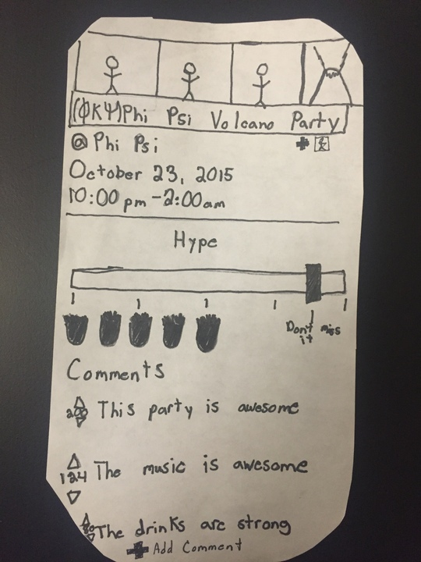
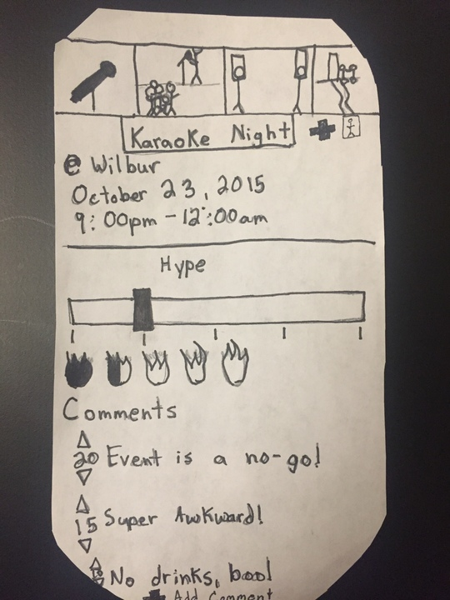
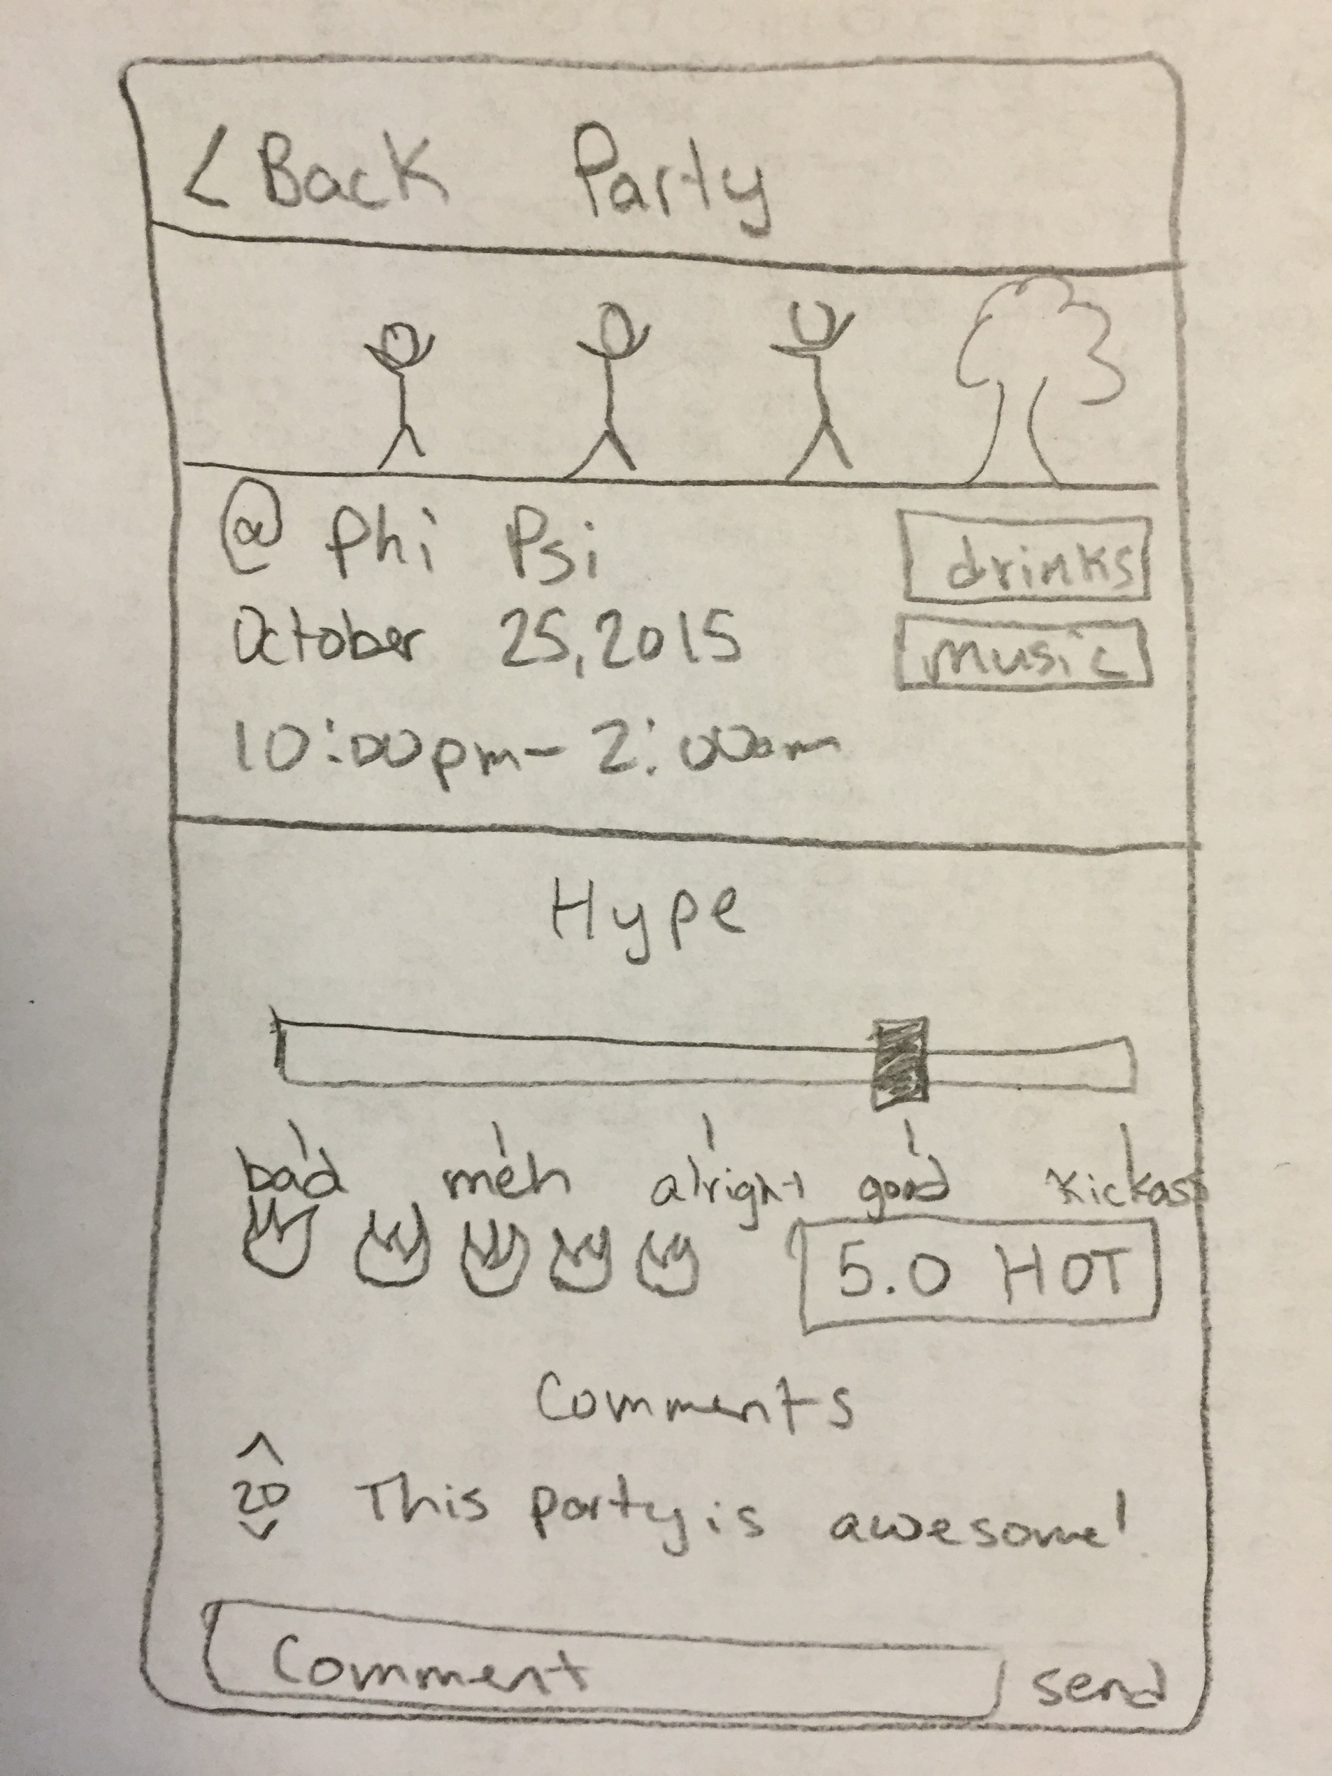
Stripping Down and Clearing Up
Unclear “Hype Meter”
Unclear “Add Picture” Button
Categories
Inconsistent
What each point means
Explicit rating
Integrated comment bar
Poorly fit “Comment” Button

Slide 5
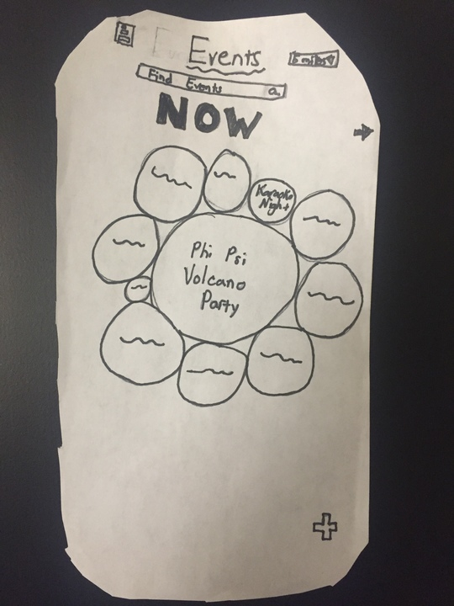
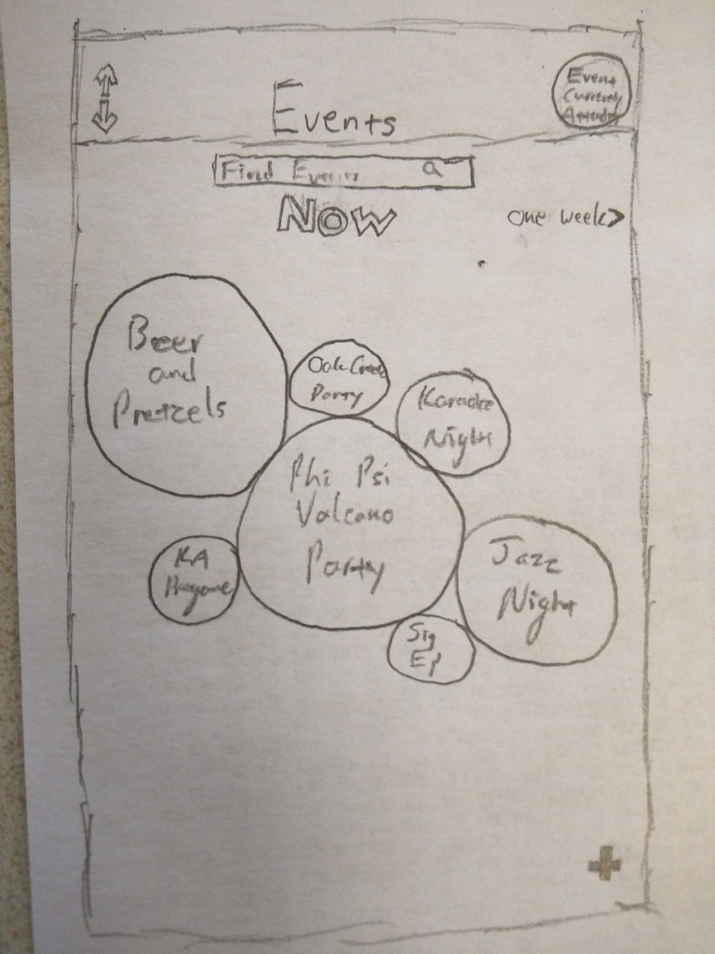
Revised Interface Design: Intuitive Navigation
Unclear “Sort” Button
More indicative button
Explicit navigation
Explicit “Back” button
No Back Button
Low-fi sketches
Revised sketches

Slide 6
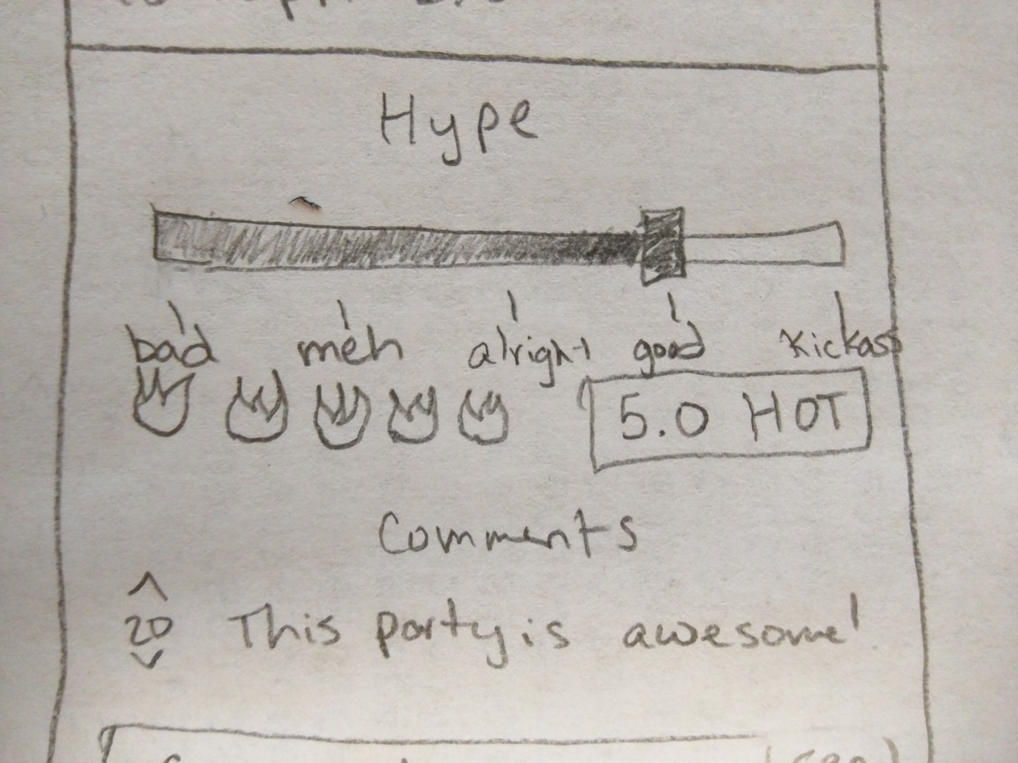
Revised Interface Design: RSVP
Shaded slide bar
Underwhelming RSVP

Slide 7
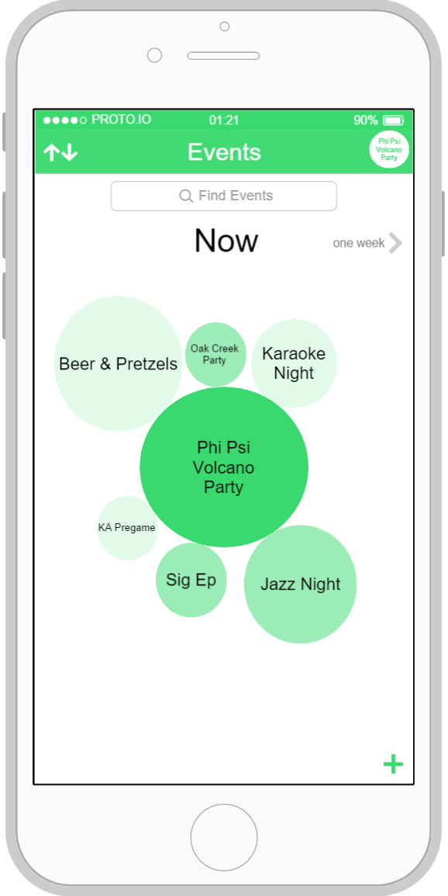
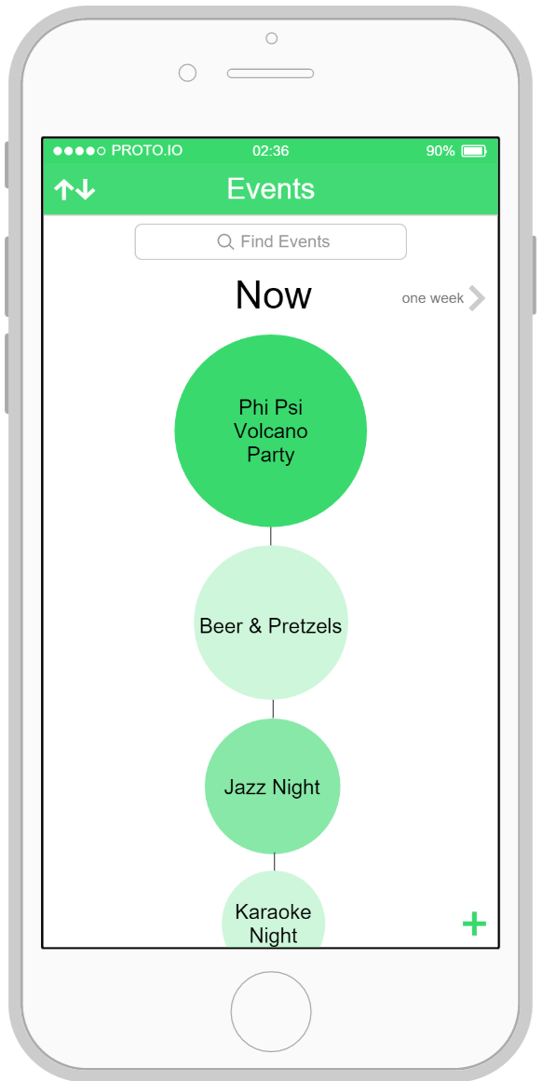
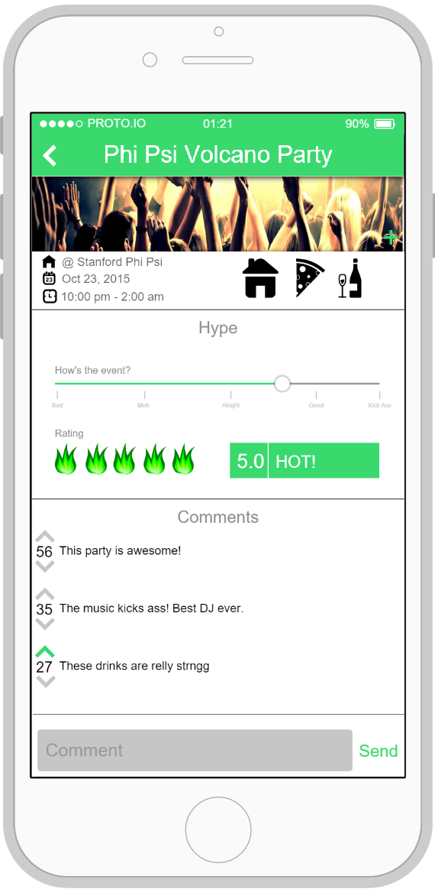
Informed Decision Making
Or

Slide 8
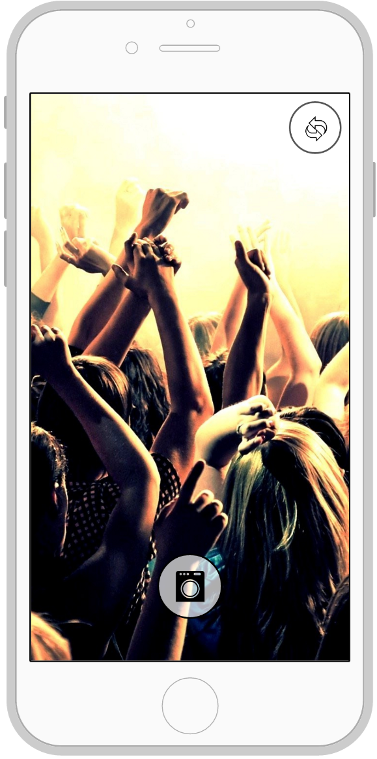
Share Event Information

Slide 9
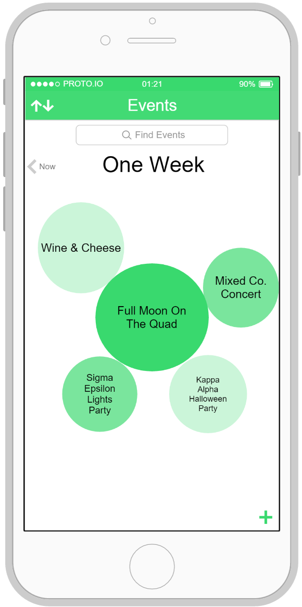
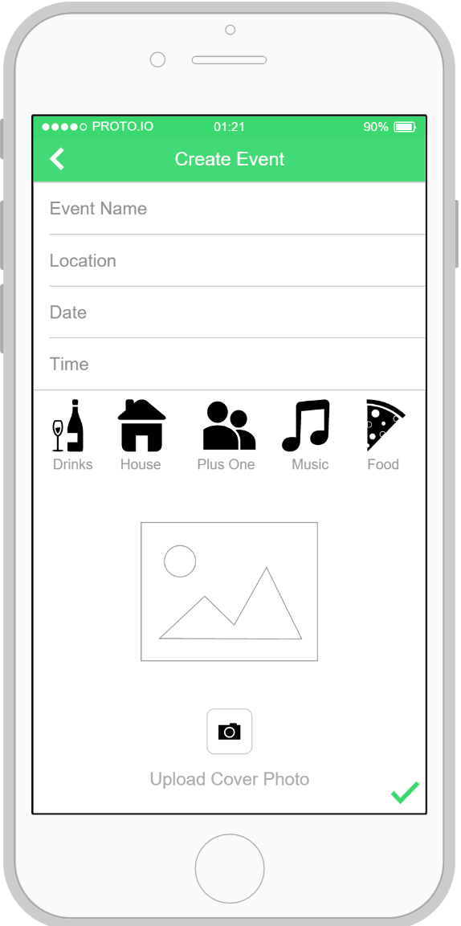
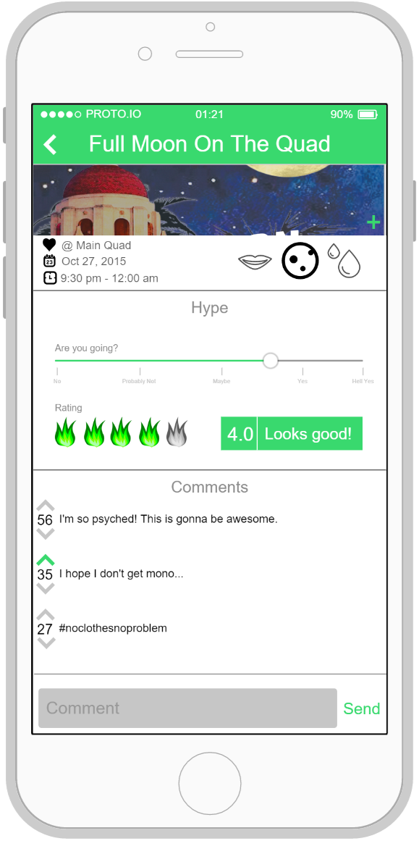
Create Event

Slide 10


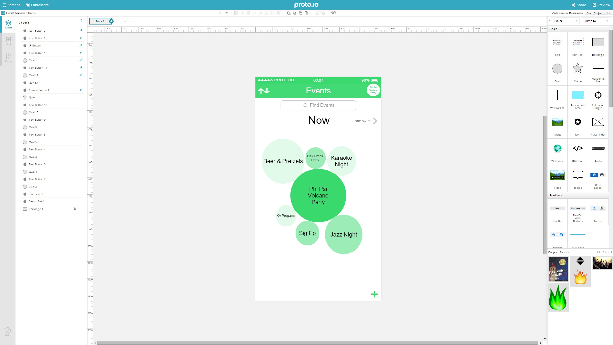
Elements
Icons/Assets

Slide 11
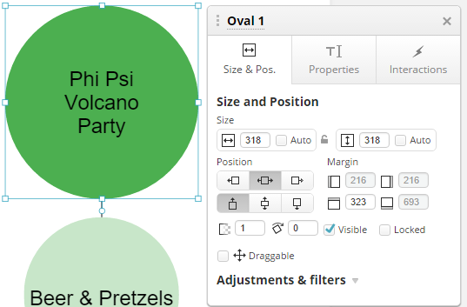
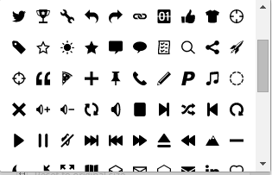
Good
Ability to explicitly review/undo actions
Vast selection of icons & assets
Great quick previews
Clean and pleasant design
Feature heavy
Icons
Element Customizer

Slide 12
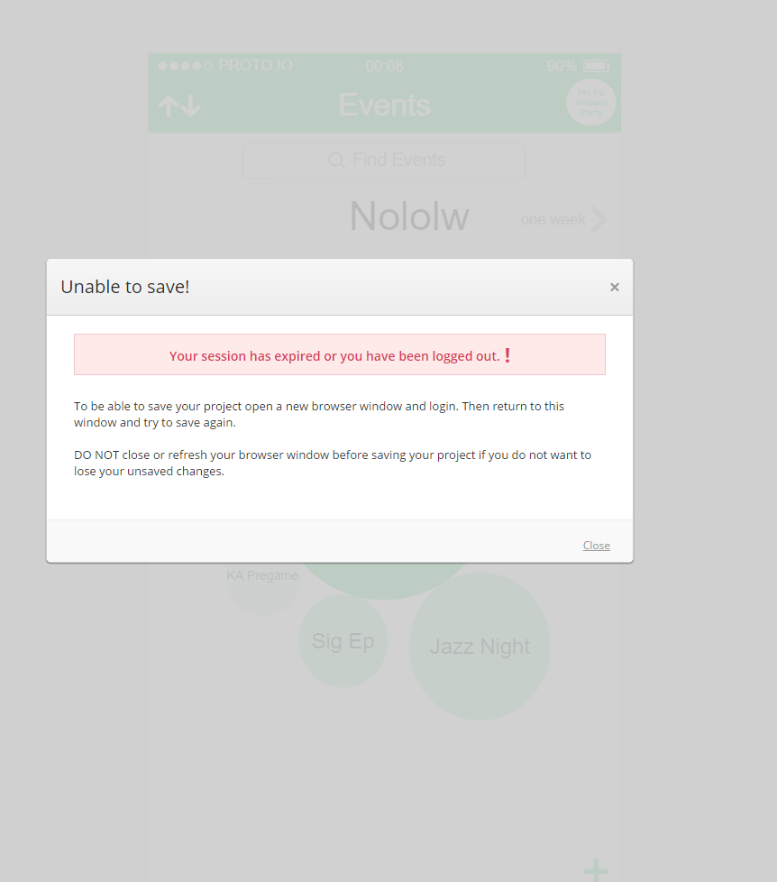
Bad
Not exactly right
No live collaboration
Limited customization of elements
Sloppy clicking functions
Hard to navigate
Not a camera..

Slide 13

Summary
Fixed errors
Cleaned the UI up
Added some functionality
Next:
Ironing out the fine details
Moving on to producing some code

